Slide 1
Building 21st Century Organizational Strategic Capacities
A Case Study of Workforce Transformational Change
Presenters: Regina Bourne, Director of HR and Organizational Development. Xuemao Wang, Dean and University Librarian
Contributor: Jenny Mackiewicz, Coordinator, Special Projects & Programs
University of Cincinnati Libraries

Slide 2
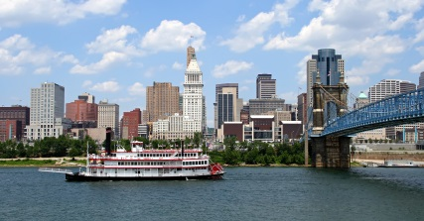
Cincinnati, Ohio
Located on the Ohio River
Over 2 million people in the Cincinnati Greater Metropolitan Area
Home to 18 universities, colleges and technical schools
Home to astronaut, UC professor and the first man on the moon, Neil Armstrong
The Procter & Gamble Company (P&G) was founded here in 1837
University of Cincinnati Libraries

Slide 3
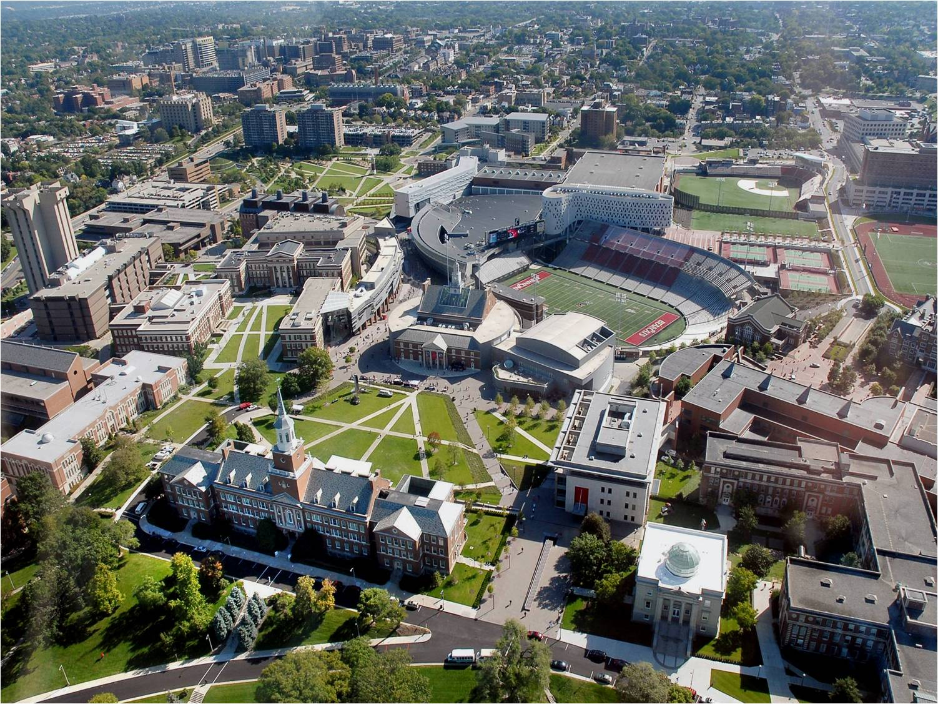
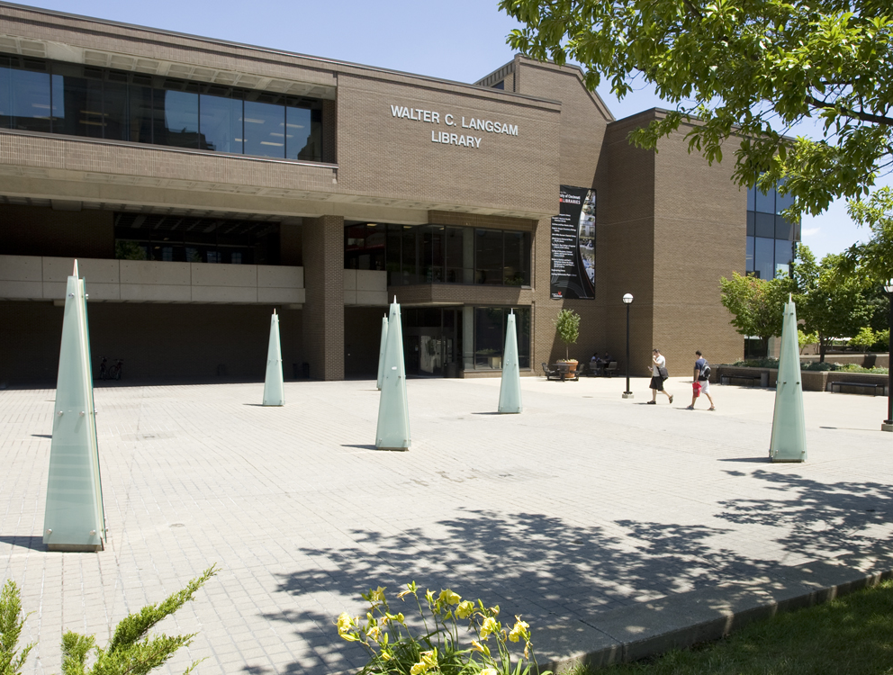
University of Cincinnati
UC Libraries
44,251 Total Enrollment
379 Programs of study
18 to 1 Student/faculty ratio
14 Colleges
First co-operative education program at a university in the US
First oral polio vaccine was created here by Dr. Albert Sabin
10 Library Locations
(13 counting jurisdictions)
4,500,741 Total Volumes
1,378,224 Gate Count for All Libraries
37 Faculty
27 Paraprofessionals
45 Administrative & Professional
University of Cincinnati Libraries

Slide 4
Drivers for Change
Why do we pursue change?
Evolving landscape of higher education and academic and research libraries
Maintain relevancy and define new value proposition
Increase strategic capacity and retrain existing workforce
Infuse new workforce with an innovative, risk-taking mindset and digital culture
University of Cincinnati Libraries

Slide 5

The Strategic Plan
The University of Cincinnati Libraries will become the globally engaged, intellectual commons of the university- positioning ourselves as the hub of collaboration, digital innovation and scholarly endeavor on campus.
Digital Technologies & Innovation
People
Space
Data to Information to Knowledge
University of Cincinnati Libraries

Slide 6
The Strategic Plan
The University of Cincinnati Libraries will become the globally engaged, intellectual commons of the university- positioning ourselves as the hub of collaboration, digital innovation and scholarly endeavor on campus.
People
Developing a Diverse Workforce
Recruit, Partner, Cultivate and Empower
Become a Comprehensive Learning Organization
Transform the evolving role of the information professional.
University of Cincinnati Libraries

Slide 7
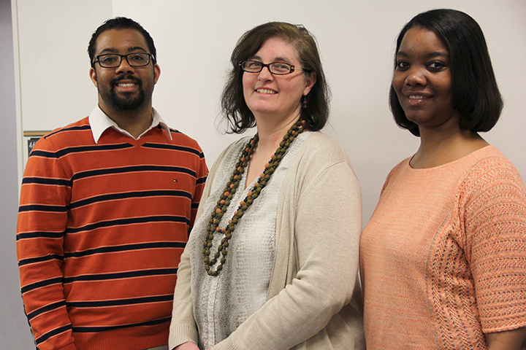
Developing a Diverse Workforce
A Broad Definition of Diversity for an Emerging Organization
Hire librarians with diverse skill sets, credentials and work experience
Create hybrid roles with in a matrix based organization structure
Establish new roles for library professionals such as:
  Informationist (4)
  Digital Scholarship Center Co-director (2)
  Digital Metadata Librarian (2)
  Digital Analyst & Developer Librarian (2)
  Digital Content Strategist
  Digital Archivist/Record Manager
  Global Services Librarian
  eLearning Coordinator
  Assistant Vice President for Research
  Scholarly Communications & Digital Publishing Strategist
  Library Chief Technology Officer
The Informationists
From left to right: Don Jason, Clinical Informationist; Amy Koshoffer, Science Informationist; Tiffany Grant, Research Informationist
University of Cincinnati Libraries

Slide 8
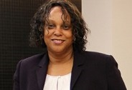
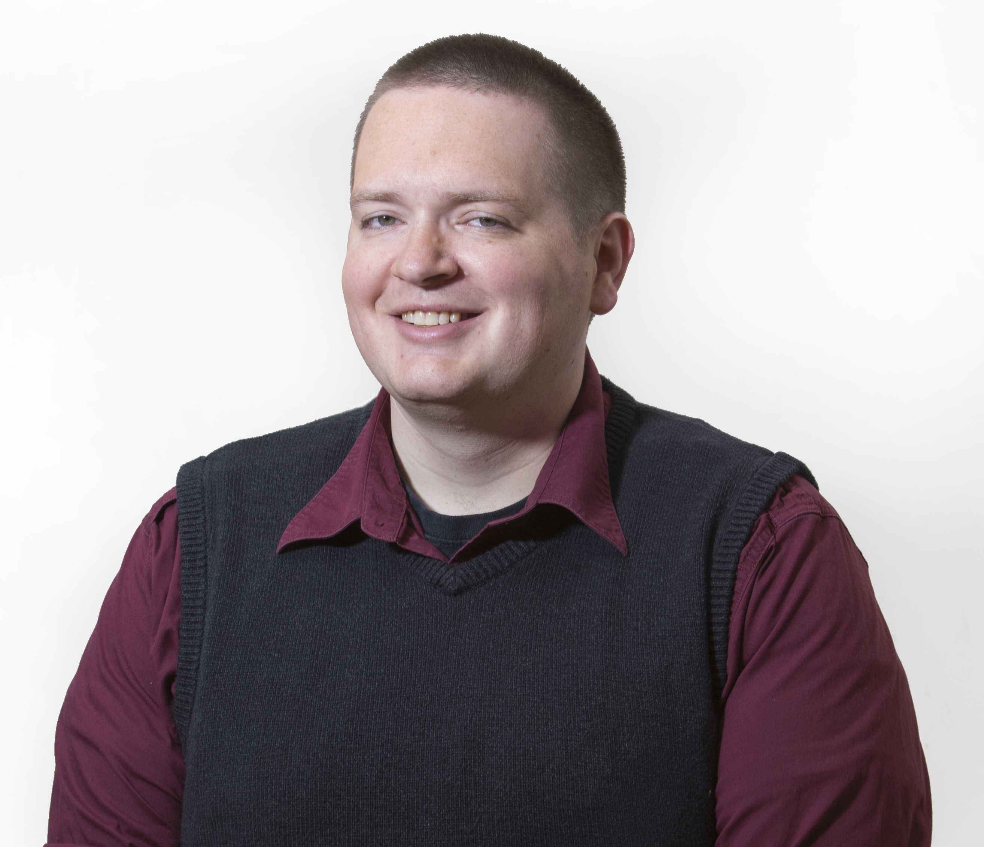
Workforce Growth
Hire new
Develop/repurpose from within
Partner/collaborate with other academic units
Fresh perspective, new skill sets, fast return on investment for new strategic directions
Lori Harris
Assistant Director of Health Sciences Library and Winkler Center Operations
Create opportunities, good for morale and sustainability, help strengthen integration between new and existing workforce
Robert Freeman
eLearning Coordinator
More integrated with the academic core, increase capacity with limited funding
University of Cincinnati Libraries

Slide 9
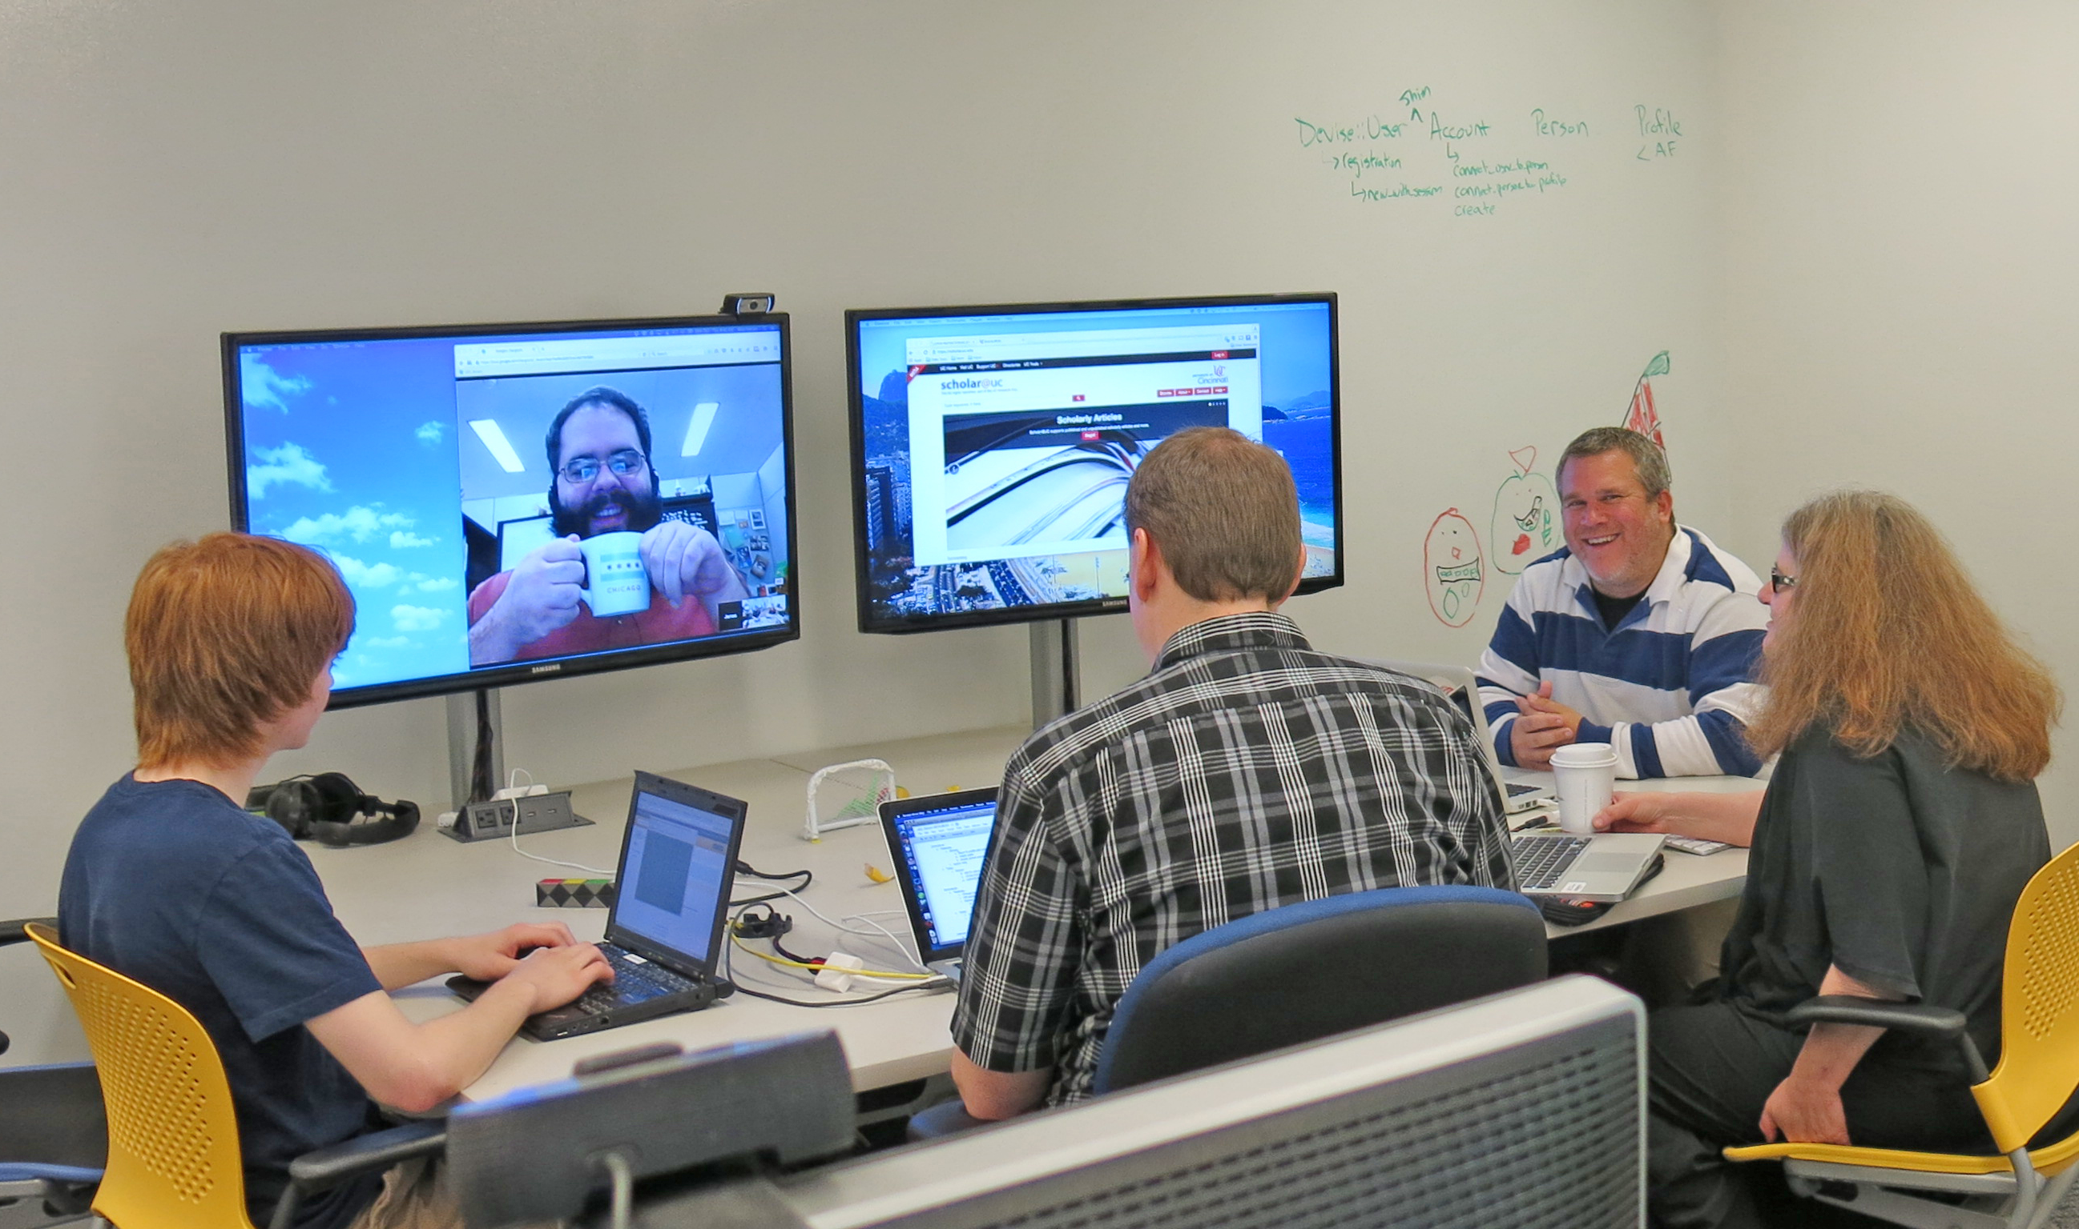
Recruit, Partner, Cultivate and Empower
The Well-Trained, Collaborative and 21st Century Knowledge Worker
Partner with i-Schools and CLIR to source talent
Develop Early Professional Fellow positions and plan for future CLIR Fellows.
Create opportunities to repurpose, build and retrain new skills
Build partnerships within UC academic communities and beyond
Scholar@uc
UC Libraries’ Next Generation Digital Repository
University of Cincinnati Libraries

Slide 10
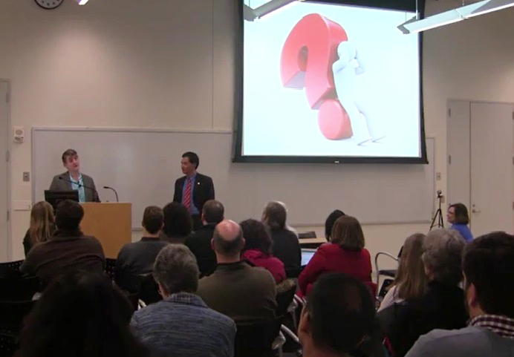
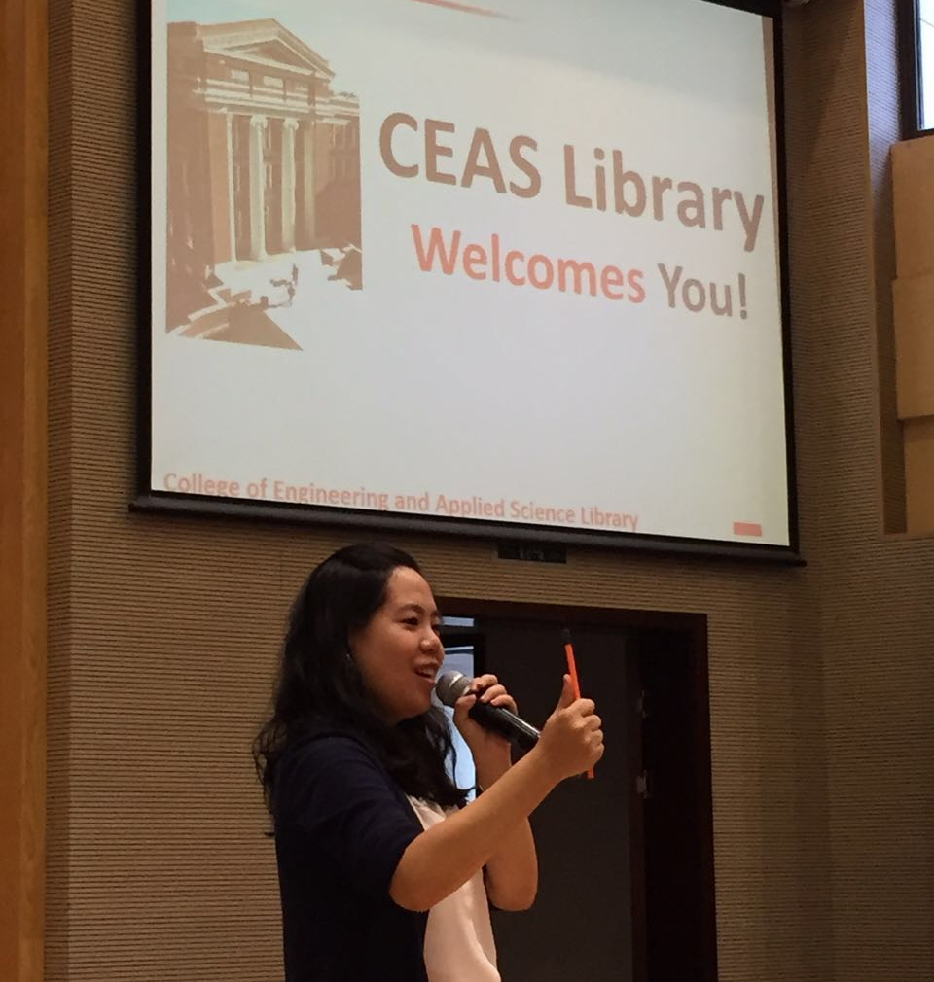
Partnerships
Vice President of Research and CIO
Digital Media Collaborative (DMC)
Joint Engineering Co-op Institute (JCI)
Digital Scholarship Center
President/Provost Office – UC Press
DMC Director Matthew Irving
Presenting at Dean Wang’s Biannual “Dean’s Chat”
UC’s College of Engineering and Chongqing University (CQU)
Global Services Librarian Hong Cheng
JCI’s Freshman Orientation 2016
University of Cincinnati Libraries

Slide 11
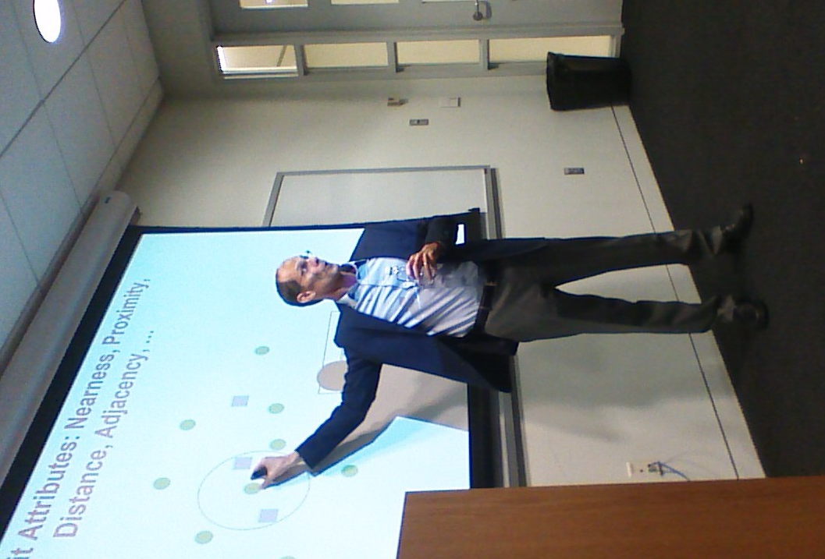
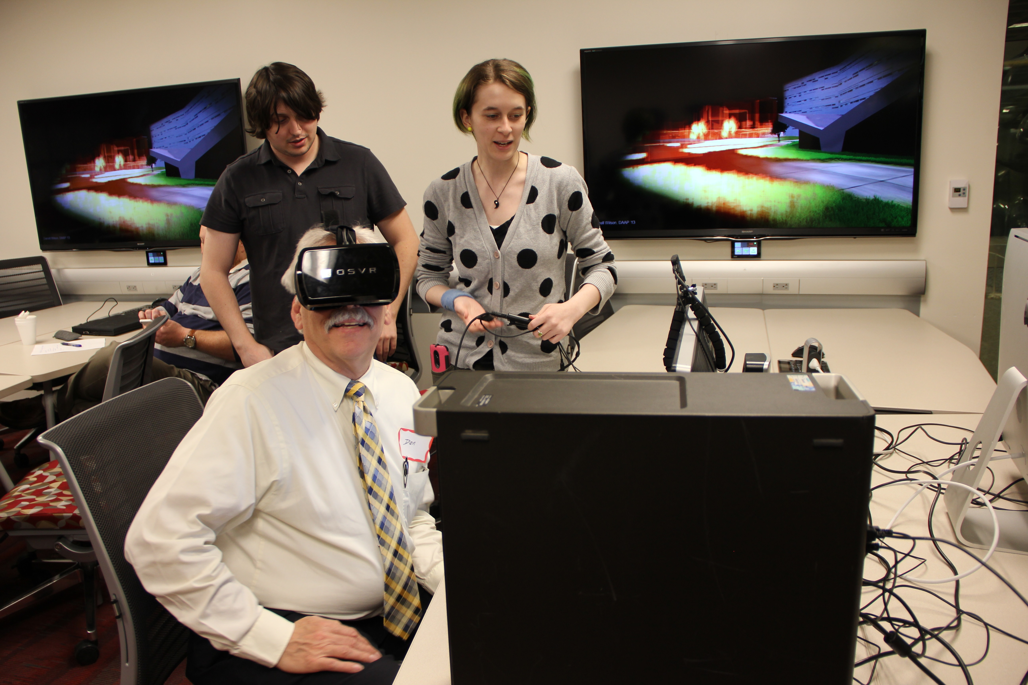
Become a Comprehensive Learning Organization
The Journey from Excellence to Eminence
Encourage continuous learning
Entrepreneurial thinking
Explore new avenues of growth
Participants of UC Libraries’ 2016 THATCamp
The Humanities and Technology Camp
GIS Day 2015 Speaker Dr. Alan T. Murray
Geographic Information Systems
Photo credits: Song Shu, graduate student, UC Department of Geography 2015
University of Cincinnati Libraries

Slide 12
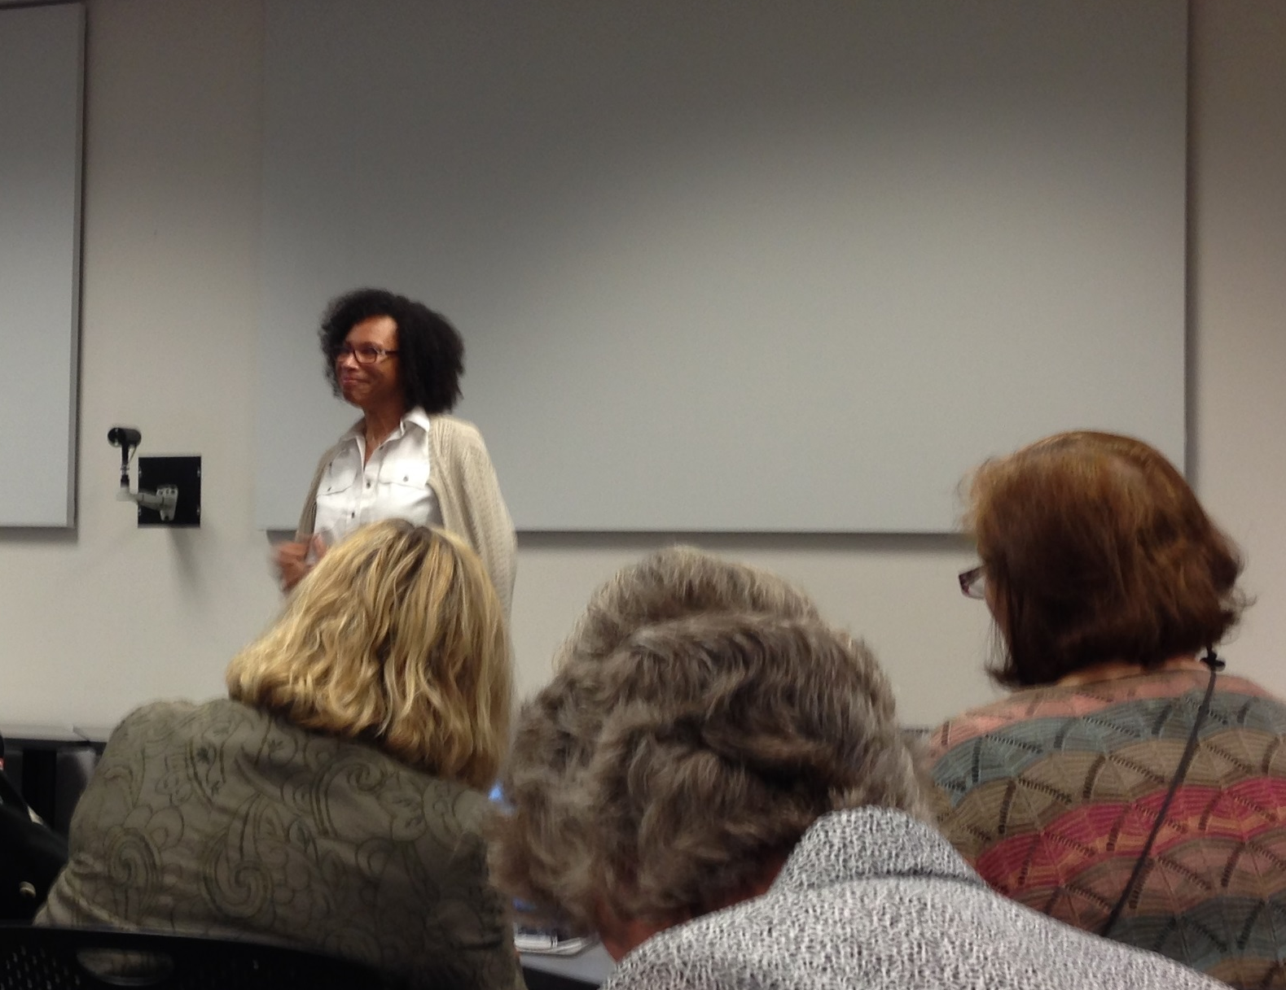
Designs for the Future
Organization Development (OD) Initiative
Continuous Excellence
Foundation in the Strategic Plan’s 11 Tenets
Strategic Plan Intervention
Spreading the word
Regina Bourne sharing the new OD plan with UC Libraries’ Faculty
University of Cincinnati Libraries

Slide 13
Lessons Learned
Organization complexity in labor relations
Change takes time, and it is hard work
Change is hard, and to sustain the change is even harder
Visionary leadership with consultative and participatory decision-making
There won’t be 100% agreement – but take risk, hope to fail fast, and try again
There is no over-communication
University of Cincinnati Libraries

Slide 14
Thank you Questions?
University of Cincinnati Libraries

