Slide 1
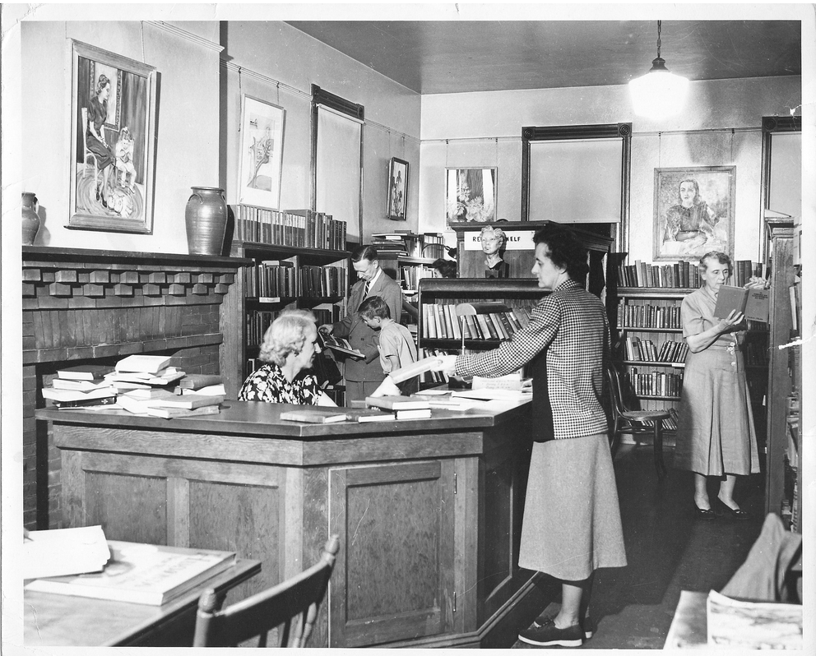
Who is doing what, when, where and how in Canada's public libraries?
Managing Human Resources in the library and information context: How do we want to work tomorrow?
Siobhan Stevenson, Associate Prof., Faculty of Information, University of Toronto. Aug 10, 2016. IFLA Satellite, Toronto
Notes:
Add subtitle

Slide 2
If…
Reference desks being dismantled
Collections downsized
Acquisitions & cataloguing outsourced
Circulation clerks replaced
“Customers” asked (and able) to do more

Slide 3
Then,
What are public librarians doing?
What are the clerical staff doing?

Slide 4
Research Design & Data Collection
Visited 12 urban libraries across Canada (all provinces except Quebec)
Conducted 70 in-depth interviews with CEOs, librarians and clerical/paraprofessionals
Job shadowed approximately 55 library workers

Slide 5
Findings
Shared ideas across the sector (regardless of geography or position)
Space (community, more and beautiful)
Collections (about those books)
Programming (adults)
Technology (access, exposure & teaching)
Notes:
Common ground

Slide 6
Findings
Competing ideas/differences in perspectives based on position, geography, other?
Role of the professional librarian and paraprofessionals
Greatest challenges/rewards of the job
Role of the library into the future and implications for the workforce

Slide 7
CEO comments : historic change, “the past was merely prelude”

Slide 8
Triangulating our empirical work: content analysis of job ads
Source | Date Range | # of individual ads
Globe & Mail (national edition) | 1950 – 2005 | 1,933
Ontario Library Review | 1950 – 1982 | 728
Feliciter (association journal/ national) | 1950 – 1975 1980/1985/1990/1995 | 514 135
Faculty of Information Job Board | 2006 – 2015 | 1,083
TOTAL |  | 4393

Slide 9
For Today’s Discussion
Source | Date Range | # of individual ads
Faculty of Information Job Board | 2006 – 2015 | 1,083
Our sample
Source | Date Ranges | # of individual ads
Faculty of Information Job Board | 2007 2011 2015 | 89 74 36
TOTAL |  | 199

Slide 10
Working Hypotheses
1. Employment Conditions
2. Staff Complements/ Ratios
3. Job Content

Slide 11
Findings: predictable & less so
(1) EMPLOYMENT CONDITIONS
Number of advertised positions decreased over period of study (N=199)

Slide 12
EMPLOYMENT CONDITIONS
Number of contract positions increasing
Question: Is this a contract position?

Slide 13
EMPLOYMENT CONDITIONS
Percentage of ads for full-time over part-time hours

Slide 14
(2) STAFF COMPLEMENTS
Ratio of public librarians to other professionals

Slide 15
(3) JOB CONTENT
jurisdictional knowledge
vs.
generic KSAs
Notes:
Much more complicated question– far deeper implications for the workplace, the viability of the profession, the preparation of professionals, and services.
Requires a close reading/ content analysis at the level of the individual job ad. This especially if one wants to consider the relationship between the story job ads in the aggregate tell us and what CEOs, librarians and professionals in the field express.
The concept of jurisdictional knowledge comes from the sociology of professions, and refers to professional knowledge gained through a formal process of training/apprenticeships and education (advanced degrees) and which forms not only the foundation for the profession but also the boundaries with which the profession that distinguishes it from all other professions. These knowledge domains and boundaries are reinforced through professional associations, government regulatory bodies, licensing institutions, etc. Law, medicine, nursing, engineering, etc. All examples.
Significantly, with the transition to contemporary info societies including the rise of the web, the ubiquity of information, and an increasingly educated population, these boundaries around “esoteric” knowledge are not as firm as they once were. Librarianship like law and indeed medicine have had to respond/adapt to these challenges to their historical authority, and for librarians, other professions have emerged to challenge our monopoly within the information industry.
But to return to jurisdictional knowledge. What then should a professional librarian know? As compared to a paraprofessional or any other employee/volunteer?
There is a massive literature dating from the 1980s that takes as its unit of analysis, the job ad. Most recently, interest has turned to the question of competencies– a concept that in itself is somewhat challenging
For our coding dictionary: Bronstein, J. (2015). An exploration of the library and information science professional skills and personal competencies: An israeli perspective. Library and Information Science Research, 37(2), 130-138. Created a typology comprising 49 jurisdictional competencies based on ALA’s 2009 list of professional competencies, as well as her interviews with CEOs and directors of information agencies, and a review of library school curriculum.
She organized her competencies into 4 clusters:
(1) provision of information services,
(2) organization of information,
(3) technological skills, and
(4) personal competencies (non jurisdictional– management skills )–
For our purposes we we cross checked with Goleman’s EQ inventory, eliminated redundancies and except for knowledge of a foreign, felt that these aspects well covered by EI inventory:
Social skills
Self regulation
Motivation
Empathy
Self Awareness.
Sidebar: Need to appreciate what qualifies as jurisdictional knowledge/ and what does not (in other words, KSAs that could be possessed through other experiences, education, etc. Note: issue re. competencies (including those ads that focus on these). Having said that ALA published a comprehensive list of competencies for LIS. Meanwhile there exist endless lists if these…Recently, as the discourse of competencies and KSAs (knowledge, skills and attributes/ attitudes) tops the public policy agenda, uncovering their articulation in job postings has become a primary focus. Often these entail matching the professional competencies as identified by the ALA Core Competencies for Librarianship (2009) with those listed in job advertisements. Further, as these competencies are explicitly tied to program accreditation, graduate schools are cited as key beneficiaries of this type of work.

Slide 16
Jurisdictional Clusters | Generic KSAs
CI Provision of information services C2 Organization of information C3 Technological Skills C4 Personal/ Management and Administration | EI/EQ Social skills (leadership, dynamism) Self regulation Motivation Empathy Self Awareness
Other as per literature but difficult to place… Community organizing Teaching, instructional design, UX Social work skills Customer Service Cultural Programming Readers Advisory and reading promotion Awareness of municipal politics, public administration, local government Community mapping and programming for sustainable economic development Popular culture Technological knowledge Advocacy and promotion
Notes:
Problem: missing some of the “competencies associated with public library work
C1 Provision of Information Services:
Reference Skills
User Services
Instruction Skills
Information gathering/profile building
Research Skills
Analysis of data and report writing
Information searching and retrieval
database searching
Analysis of data and report writing
Information searching and retrieval
Database searching
C2 Information Organization
Cataloguing
Serials Management
Collection Development
Classification
Licensing and vendor relations for databases, ebooks, etc.
Knowledge Management
Records Management
Indexing
C3 Technology
Website Maintenance
Usage maintenance of library programs
Content Management
Network Management
Work with social networks
Database Management
Website Design
Internet Skills
Project Development/Management
Computer Skills
Website Management
Programming skills
Database Design
Demonstrate an interest in learning about new technology trends and a willingness to experiment/adopt new technologies
Beile & Adam (2000) added electronic services to technical and public (338).
C4 Management and Admin
Supervision
Budgeting and Financial Planning
Strategic/Service Planning
Service Assessments/Measuring Performance (of library systems)
Report Writing and/or Board Relations
HR: hiring & firing, performance appraisal
Advocacy
Library Marketing & Promotion
Other
Relatively standard, and indeed Bronstein found:Job listings were found to emphasize skills related to the provision of information services as well as personal competencies, while results from the survey revealed that skills related to the organization of information were perceived as essential by library directors. Data collected from course descriptions suggested that LIS departments prepared students to work in advanced technological environments but they did not develop their personal competencies. Traditional LIS skills that support design and provision of information services and making information accessible are still relevant today, while being flexible enough to adapt to changing information environments based on user-centered philosophies of service. • A typology of 49 LIS skills and competencies was developed using content analysis. • Job listings looked for information provision skills and personal competencies. • Library directors emphasize the need for skills related to the organization of information. • Course descriptions focus on the acquisition of technological skills

Slide 17
Recall what CEOs are saying…
Notes:
Continuum: at one end the library as
cultural centre (curation, programming, architecture and design, maker spaces) , at the other (that population that does use the library or would if we could get away from the “public-ness” of it all. Here building is privileged
At the other
community-led librarianship (public library staff in the community)– those x% per who do not use the library, its about relationships not about buildings
And in between these two various attempts to balance the needs of broad and diverse urban communities while maintaining relevance to funders.
Other attributes that create confusion: innovative, flexible, dynamic, etc.

Slide 18
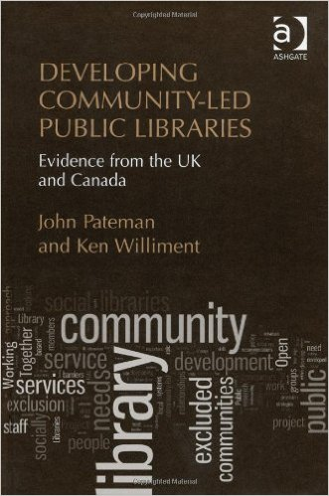
A CONTIUUM OF VISIONS
The Change Imperative
Notes:
What kinds of people: in both the concern is not with professionally trained per se, but with people with the right attitude…
After the interviews, I was interested to see what job ads would tell us: how were these unique positions and novel requirements beimg represented
In the main, and consistent with research into job ads, they are in fact highly conservative and reflect the classic skill sets despite language, this to the contraryof not only what CEOs but librarians and clerksare doing as well.
But a few instances that I think bear noting...

Slide 19
What we found in the job ads
CI Provision of information services
Notes:
Under technology: project management, computer skills, usage and maintenance of library programming database
Exactly what we were told we would: Further a review of this vast literature, was relatively consistent:
communication skills (written and oral) increased importance leadership & teamwork qualities may trump traditional management?
BUT IN THE END WE WERE INTERESTED IN THE COHERENCE BETWEEN WHAT CEOs WERE TELLING US AND WHAT THE JOB ADS WERE TELLING US

Slide 20
What we found in the job ads
C2 Organization of Information
Notes:
Exactly what we were told we would: Further a review of this vast literature, was relatively consistent:
(1) communication skills (written and oral) increased importance leadership & teamwork qualities may trump traditional management?
(2) EI—goes to maturity, adaptability, self reflexivity, self starter, self motivated, etc.
(3) some concern that general KSAs trump jurisdictional knowledge but ALA degree and competencies holding strong
(4) lack of specificity with respect to IT skills although a curiosity and interest is often indicated as desirable
(5) entry-level positions now requiring previous library experience
(6) increasing number of tasks associated with individual jobs— or combined jobs (branch manager & children’s services)
less postings than at other times
BUT IN THE END WE WERE INTERESTED IN THE COHERENCE BETWEEN WHAT CEOs WERE TELLING US AND WHAT THE JOB ADS WERE TELLING US

Slide 21
What we found in the job ads
C3 Technology
Notes:
Ad 33 good list of classical skills and Oshawa Childrens Librarian, Ad 108
for example:
Under the direction of the Head of the Department, this position uses professional skills to plan and conduct programmes for children and adults; provide library service to children and adults including service at the circulation and reference desk, provide reader’s advisory; help with collection development and maintenance which may include selection and weeding of materials; and is in charge of the Department in the absence of the Department Head.

Slide 22
The More Things Change? What Job Titles Tell Us
2007 | 2011 | 2015
Community Development & Programming Librarian | Community Outreach and Promotions Technician | Tech Bar Assistant
Community Partnerships Coordinator | Community Outreach Librarian | User Experience Librarian
Library Technologies Specialist | E-resources Online Course Tutor | Youth Services, Senior Information Services Technician
Manager of Innovation and Technology | Librarian - Web Services
Manager-Web Services | Librarian [Assignment: Outreach-English Can Be Fun Coordinator]
Metadata Specialist | Metadata Specialist
Technology Coordinator | Technology Initiatives Project Librarian
User Experience Librarian | Virtual Branch
Virtual Branch | Web Librarian
Notes:
Okay, so what about titles
Technology and community outreach
Lots of information services aka reference work
Cataloguers
Childrens and YA librarians
Lots of management and supervisory roles

Slide 23
But there are some outliers
Coordinator, Library Communications and E-Services
Children's Specialist
CEO
Coordinator, Adult Services
Branch Manager

Slide 24
Discussion, Open Questions, Future Research
How did we fare? Reviewing our hypotheses
Caveats and limitations
Open questions
Future work
Any Volunteers?
Notes:
Challenges of job ads as the unit of analysis especially longitudinal studies: differences in layout, distribution, presentation
Discursive challenges: exceedingly difficult to operationalize or standardize concepts like “competencies, innovation, service-oriented, flexibility
Lack of research into public libraries as sites of professional and non professional work and/or analysis that look at ads across the board, may have lost some of their explanatory potential
Triangulating
Just as Bronstein combined job ad analyses with interviews with CEOs and heads of information organizations, as well as LIS curriculum, we are attempting to integrate/understand/explain what feels like a significant and historical disconnect between contemporary job ads and what CEOs, librarians and paraprofessionals in the field are saying to us. Of course the difference between our approach and Bronstein’s is that she used the interviews and curriculum to help shape the identified competencies. Our approach treated the material as essentially separate and then looked to see connections and disconnections.
For example: the ongoing significance of collection development and reference work, indeed, the number of advertised positions for work on public service desks and within the library contracts what our informats told us…
In the final analysis, this project has left us with more questions than answers. Some of these are design related (how can we exploit to better effect a database containing over 4,000 job ads) but more significantly, what really is going on out there? How are public librarians working. When some of the most powerful CEOs say: give us someone with a BA and the right attitude and we can teach the rest, and this within the context of community-led librarianship on the one side, and cultural centre on the other, as well as influences like the ischool movement....

Slide 25
Managing Human Resources in the library and information context: How do we want to work tomorrow?
Your Questions, Comments and Suggestions?

