Slide 1
Of Human Bondage: Breaking Through to Lasting Change in Information Organizations
Rajesh Singh
Assistant Professor
Division of Library and Information Science
St. John’s University
singhr1@stjohns.edu

Slide 2
We May Know the Threats…
Plummeting reference queries
Fewer books checked out
Coexistence of ebooks and traditional books
Corporate sponsorship for library programs
The ongoing conflict between libraries and publishers
Image of future librarians and libraries

Slide 3
Leading Change: The Odds are Stacked Against Us
Over 70% of change efforts fail.
Most important competency for a leader is the ability to develop strategy.
Only 4% leaders are strategists (Horwath, 2009).

Slide 4
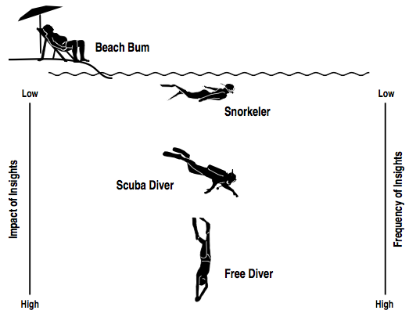
Leaders as Four Different Types of
Strategic Thinkers (Horwath, 2009)
9%
Doesn’t contribute any insight into the business
“Surface Thinking” –Offers tactical solutions that don’t impact the business.
26%
Can produce strategic insights – but needs a lot of support and collaboration in order to succeed.
32%
Leaders - Continually generating insights that transform the business.
33%

Slide 5
Understanding Human Emotions

Slide 6
There’s No Crying in Baseball!
http://www.youtube.com/watch?v=6M8szlSa-8o

Slide 7
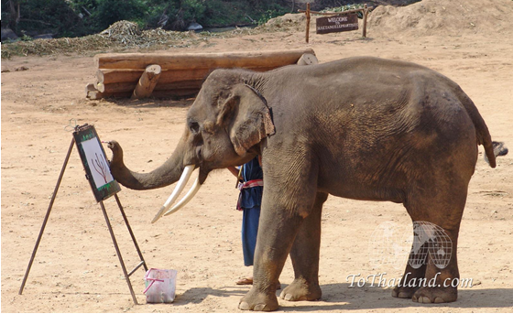
Rider and Elephant … Our Two Minds
Rider = Our Rational Mind
Elephant = Our Emotional Mind
Logic, Planning, Analyzing – “Head”
Emotion, Energy, Drive – “Heart”
Our rider struggles to keep our elephant on the road long enough to reach the destination.

Slide 8
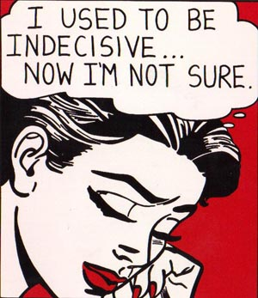
What are their needs?
Rider: needs a clear, unambiguous path…or may be paralyzed by indecision.
Elephant: needs nurturing to fuel motivation and energy for change.

Slide 9
Which is More Important?
Lack of stick-to-itiveness is usually because of…
…the Elephant.
Reason and emotion work together to create behavior, but emotion does most of the work.

Slide 10
Is it Resistance to Change… or Exhaustion?
Using “self control” or “will power” to change long-standing habits is exhausting!

Slide 11
Is it a People Problem or a Situational Problem?
Sometimes the problem is the environment – the surrounding cues discourage change.

Slide 12
Is it Resistance to Change, Lack of Clarity?

Slide 13
Case Study of a University library

Slide 14
Organization and Utilization of Electronic Resources
Problem Needing to be Addressed:
How to manage the burgeoning electronic resources that were replacing print journals and monographs.
Solution
Purchased EBSCO’s electronic resource management system (ERM)
New Problem
Nobody wanted to learn it—too overwhelming; didn’t know where to start

Slide 15
New ERM: Shaping the Path
Unsuccessful EBSCO ERM – keep it or dump it?
Staff agreed to keep it
Formed a guiding team of 3 people for the ERM implementation process.

Slide 16
New ERM: Identify “Bright Spots”
Visited another university library which implemented an EBSCO ERM
Able to see a successful implementation
Alleviated some of their major concerns and worries
EBSCO’s trainers trained the core team of 3 on multiple occasions

Slide 17
New ERM: “Shrink the Change”
New Problem: Only trained on EBSCO publications!
Needed to accommodate many other vendors (Oxford University Press, Proquest, etc.)
Decided to learn “one vendor at a time” to shrink the change.

Slide 18
New ERM: After 2 years – success!
During the process, they held weekly meetings regularly with all the units involved (Acquisitions, Serials, ILL, etc)
These meetings became a new habit for the staff, and helped further understanding of their unique issues and how they fit into the big picture.
The transition to full implementation of EBSCO ERM took two years.

Slide 19
We need a framework

Slide 20
We Need a Framework for Change
As outlined in “Switch,” we need to:
Direct the Rider
Motivate the Elephant
Shape the Path

Slide 21
Direct the Rider
Find the bright spots
Script the critical moves
Find out what’s working and
how you can do more of it.
Point to the destination

Slide 22
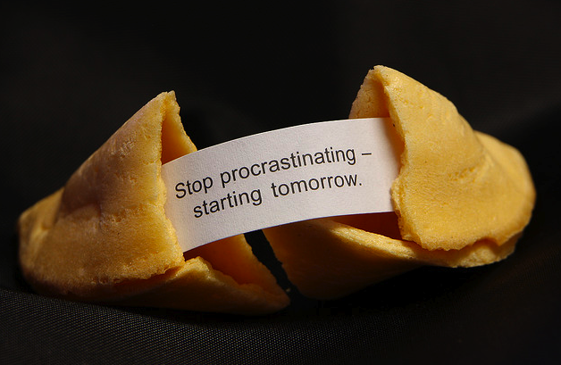
Motivate the Elephant
Put feelings first
Shrink the change
Grow your people

Slide 23
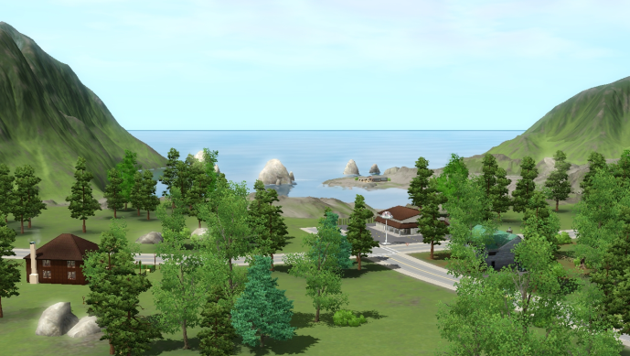
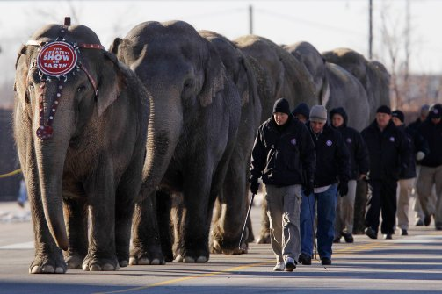
Shape the Path
Tweak the Environment
Build habits
Rally the herd

Slide 24
Harness the Heart
Help people see the problems and solutions in ways that influence their emotions, and you will harness their hearts and energy to pave the way to real, lasting change.

Slide 25
Questions?

