Slide 1
Adding A Mentoring Dimension To The Training Of iSchool Student Employees
Ravit H. David, Scholars Portal, University of Toronto
Aneta Kwak, Scholars Portal, University of Toronto

Slide 2
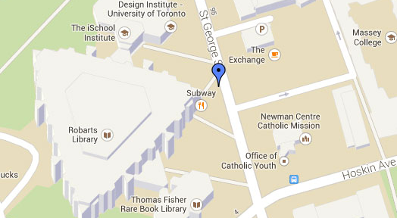
A road map for todays’ talk : → Mentoring –how and for what? → Training students vs. training iSchool students to work in the library → How training leads, if at all, to mentoring? → Mentoring for iSchool students → Who can become a mentor?

Slide 3
What is Mentoring?
“individuals with advance experience and knowledge who take a personal interest in helping the careers and advancment of their protégés. [. . .] Mentoring relationships may range from focusing exclusivly on the protégés job functions or being a close friendship" (Gale Encyclopedia of Management 2006)
Empirical, focused on results
Two dimensions: Vocational and phsyco-social
What Mentoring is Not ?
A field with one, agreed definition
Training of a new employee

Slide 4
Training Students to Work in Libraries : Students vs. iSchool Students
In both cases the hiring of temporary employees may be an issue
In both cases the number of students to train can be massive
However—
Motivation => higher interest in the position – more instances for mentoring?
Or maybe students are students?

Slide 5
I gained experience in the area I hope/ plan to work upon graduation through my work experience
Scale of 1-5, 1 being the statement does not apply, 5 being the statement greatly applies to you

Slide 6
The main value of my work experience was to provide an income to support my studies
Scale of 1-5, 1 being the statement does not apply, 5 being the statement greatly applies to you

Slide 7
Survey Participant Training Overview
If yes, who trained you?

Slide 8
Survey Participant Training Overview Continued

Slide 9
What is Mentoring for iSchool Students
”Studies suggest that majority of jobs are found through personal connections or knowing the “right” people: in other words “through networking”.” (SLA Western Canada, “Where to Look for Jobs”,http://wcanada.sla.org/where-to-look-for-jobs/)
"It goes without saying that networking and active professional involvement during your MLS education will benefit your job search. Even more benefit would be gained if you attended professional conferences, presented, got a scholarship, and/or published an article.” ( Short, G. (2014, July 8). Career advice and tips for MLIS Students. Retrieved from : http://dbiosla.org/membership/career_advice.html)
"Networking: Can help you in all steps to the job hunt process. Meeting people in the profession can lead you to new openings and provide information or referrals when you see an opening. Hey doesn’t that person work there…” (DBIO, "Career Advice and Tips for MLIS Students”, http://dbiosla.org/membership/career_advice.html)

Slide 10
Features of mentorship

Slide 11
Students Working for SP Ebook Service
Students write and update training materials
New students shadow Senior Students
Self Evaluation process (in addition to HR)
Upon leaving we ask for feedback

Slide 12
You don’t need to be a Mentor to Mentor = Mentor is a Verb!
Mentoring instances may arise regardless of the level or quality of training
Mentoring is personal and unique –you cannot mentor all of your students
Enabling iSchool students to accuire professional experience in as many tasks and develop as many skills as they can so they can be "attractive" on the job market may contribute also to work flows and work load in your department: ; Everyone can benefit from leadership
Mentoring instances enrich the work experience of students and librarians alike –find opportunities for mentoring!

Slide 13
Thank You
Ravit:
ravit.david@utoronto.ca
Aneta:
aneta.kwak@mail.utoronto.ca

