Slide 1
The Next Generation of Employees: A Study on the Factors Influencing Male Students Ages 18-30 to Become Professional Librarians in the United States
Heidi Blackburn, PhD
hblackburn@unomaha.edu
IFLA Satellite Meeting 10–11 August 2016
University of Toronto
Notes:
1

Slide 2
Research Problem
Library science has not identified the factors that currently influence Millennial males to join the library profession. Milliennials are defined as ages 18-30.
Motivational factors for members of the male library workforce in the U.S. remain obscure for the profession without insight into the dynamics of sex, gender roles, and technology in the workplace.
Notes:
2

Slide 3
Research Problem
The study addresses the questions:
What social, cultural, economic, and/or political factors influence males (ages 18-30) to become professional librarians?
To what extent has technology influenced males (ages 18-30) currently enrolled in graduate programs decisions to become professional librarians?
What professional stereotypes do males (ages 18-30) encounter?
Notes:
3

Slide 4
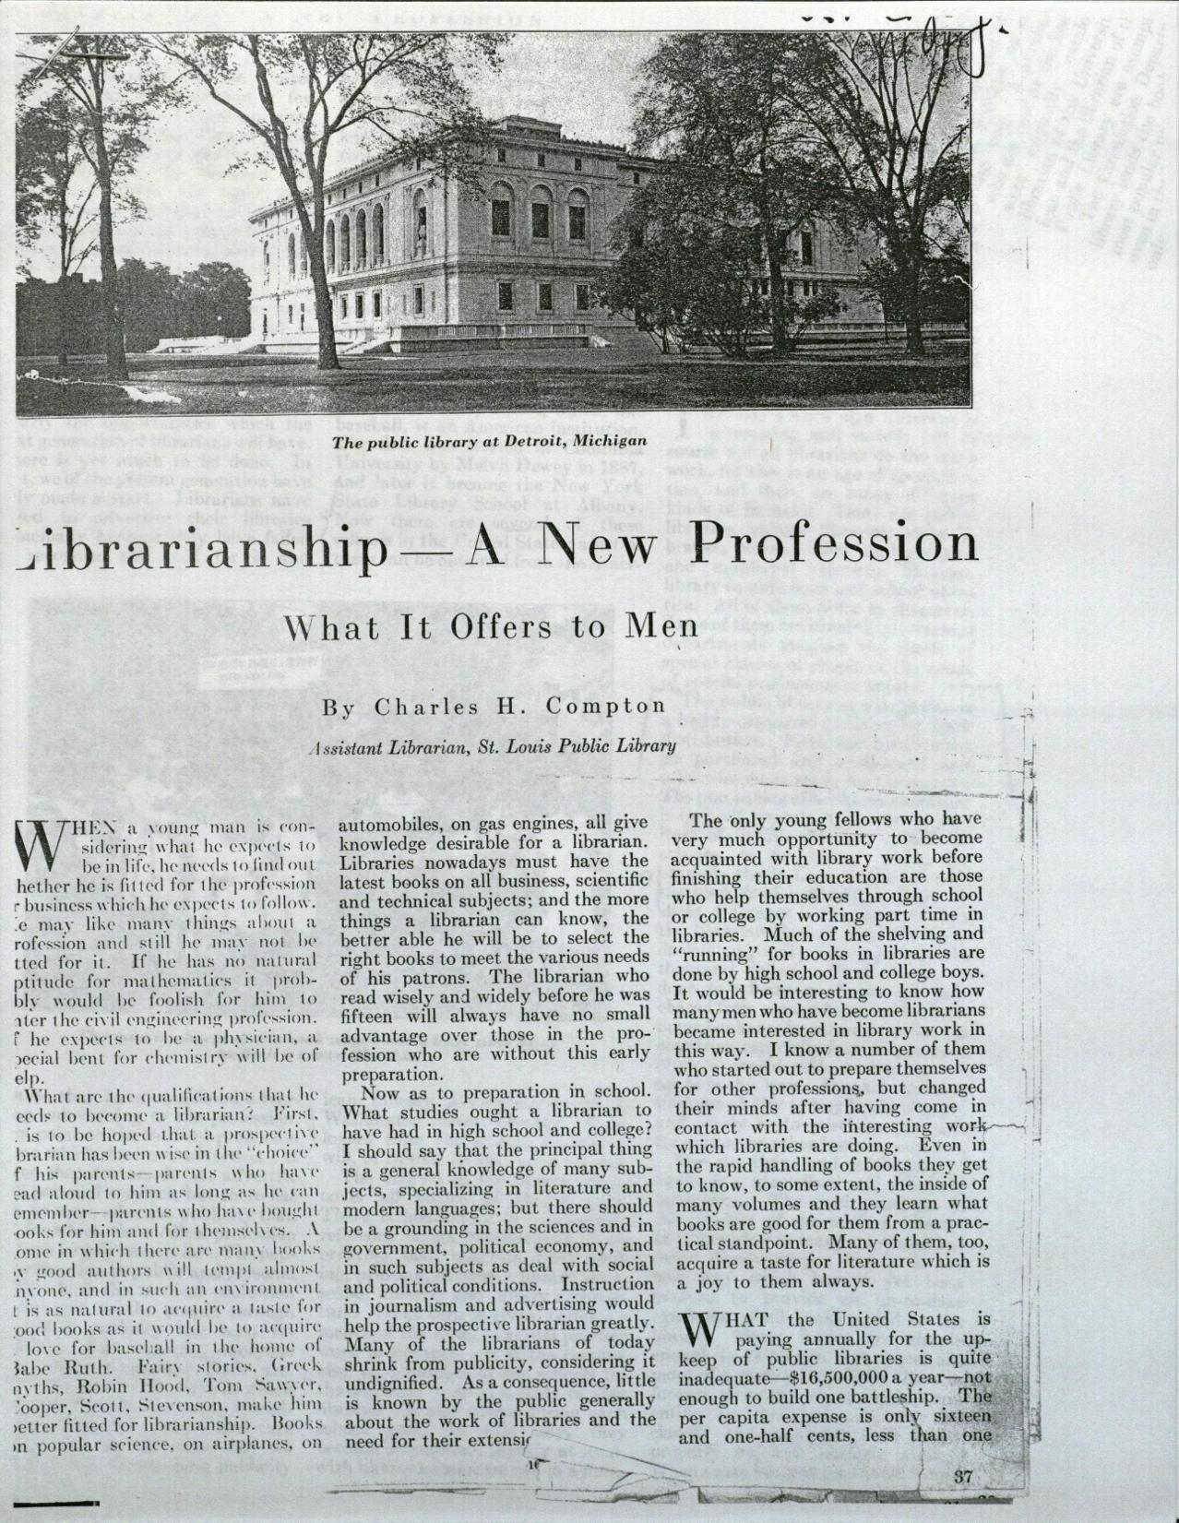
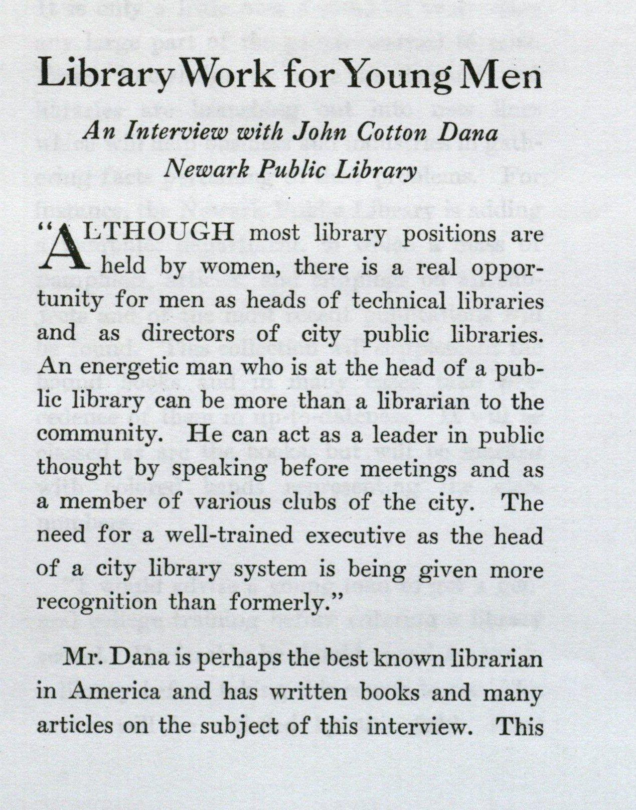
Literature Review
Three gaps were identified:
motivations for men joining the profession
insight into men in libraries as a minority group
the personal experiences of men choosing the profession as a cultural group
Notes:
4

Slide 5
Kanter’s Theory of Tokenism
Kanter’s theory of tokenism (1977):
Dominants: majority of people who share similar characteristics
Tokens: proportions of significant types of people are highly skewed and are treated as representatives of their category
Kanter suggests the problems tokens face will diminish as their numbers increase from 15%
If men now constitute more than 15% of the population, then according to the theory of tokenism, they should not experience workplace stereotyping and polarization
Notes:
5

Slide 6
Research Question
Subquestions include:
What social, cultural, economic, political, and/or technological factors influence males 18-30 currently enrolled in graduate programs to become professional librarians in the United States?
Does computer technology play any role in attracting male Millennials to the library profession?
How does Kanter’s theory of tokenism apply to male Millennials who are entering the library profession?
Notes:
6

Slide 7
Methods
Overview:
231 survey participants enrolled in 37 library and information science graduate programs across the U.S.
21 self-selected interview participants
Annual Association of Library and Information Science Education (ALISE) Statistical Reports
Included traditional library science programs and iSchools (schools who are a member of the iCaucus organization)

Slide 8
Data Collection and Analysis
Survey: topics focusing on gender, technology, library stereotypes, and personal characteristics (age, sex)
Interviews: reasons for joining the library profession, personal technology use, and encounters with librarian stereotypes; reconstructing events leading up to the decision to attend library school

Slide 9
Limitations
Population
Instrument features
Researcher restrictions
Emotional responses
Resources available
Filtering effect

Slide 10
Findings: Professional Stereotypes
75 individual responses mentioned specific negative male librarian stereotypes, instances of the participant being negatively stereotyped by the public, or instances of being negatively stereotyped in the workplace by colleagues.
The negative stereotypes encountered by male Millennials in this study focused on librarianship as a feminized profession and the male librarian as a know-it-all.
According to Kanter’s theory, this should not have occurred as the male social status in the group moves away from token.

Slide 11
Findings: Factors Influencing Men
Social factors widely appear to have the strongest influence on male Millennials to come to library school and become professional librarians.
N=220 participants
# | Topic | Strongly Agree 1 | 2 | 3 | 4 | Strongly Disagree 5 | Mean | Standard Deviation
1 | Love of books | 99 | 89 | 17 | 12 | 3 | 1.78 | 0.91
2 | Work experience | 74 | 59 | 38 | 29 | 20 | 2.37 | 1.31
3 | Non-threatening work environments | 25 | 60 | 70 | 52 | 13 | 2.85 | 1.09
4 | Social improvements | 65 | 81 | 34 | 30 | 10 | 2.27 | 1.16
5 | Library management | 65 | 72 | 48 | 24 | 11 | 2.29 | 1.15
6 | Computer technologies | 31 | 67 | 62 | 45 | 15 | 2.75 | 1.14
7 | Financial means | 49 | 96 | 31 | 34 | 10 | 2.36 | 1.12
8 | Public work | 37 | 83 | 51 | 37 | 12 | 2.56 | 1.12
9 | Gaming | 15 | 27 | 42 | 79 | 57 | 3.62 | 1.19

Slide 12
Findings: Computer Technology
Participants were influenced by the desire to use computers and new computer technology.
The largest group of responses in both the survey (20/84) and interviews (7/21) supports the idea technology plays a role for attracting men in general to the profession overall.
76% of respondents (113/148) from traditional programs “Strongly Agree” or “Agree” that computer technology was a factor in the decision to become a professional librarian, compared to 44% of iSchool participants who “Strongly Agree” or “Agree” (32/72).

Slide 13
Findings: Kanter’s Theory
The presence of solos makes dominants more aware of what they have in common.
Men are still being negatively stereotyped both in the library workplace and in public perceptions.
Gender was a distinct factor in the decision to delegate a task to a male or female library employee.
Male librarians must either ignore or work hard to fight stereotypes because they are unable to disprove the stereotypes by example.
Assimilation occurs through stereotypes because the majority group shapes the characteristics of the male librarian to fit the generalization.

Slide 14
Significance
Fills important gaps in the professional literature in librarianship and psychology
Could influence best practices for recruiting men from traditional programs such as literature and history, as well as unconventional programs, including computer science and instructional design
Notes:
14

Slide 15
Conclusions
Many positive social factors strongly influence male Millennials to attend LIS programs to become professional librarians in the United States.
Students perceive the benefits of becoming a librarian outweigh the aspects of polarization and visibility.
Negative male librarian stereotypes are no longer strong enough to keep men from becoming professional librarians in the United States.
Kanter’s use of a mathematical equation to equalize employee numbers does not solve the problems tokens face in the workplace in the U.S.
Notes:
15

Slide 16
Thank you for participating!
Please contact me: Heidi Blackburn hblackburn@unomaha.edu or @heidiblackburn
See the full dissertation at: http://digitalcommons.unomaha.edu/crisslibfacpub/13/
Notes:
16

