Slide 1
The Beginning of a Beautiful Friendship
IFLA Satellite Meeting
Toronto, Ontario
Dr Guy Berthiaume
August 10, 2016

Slide 2
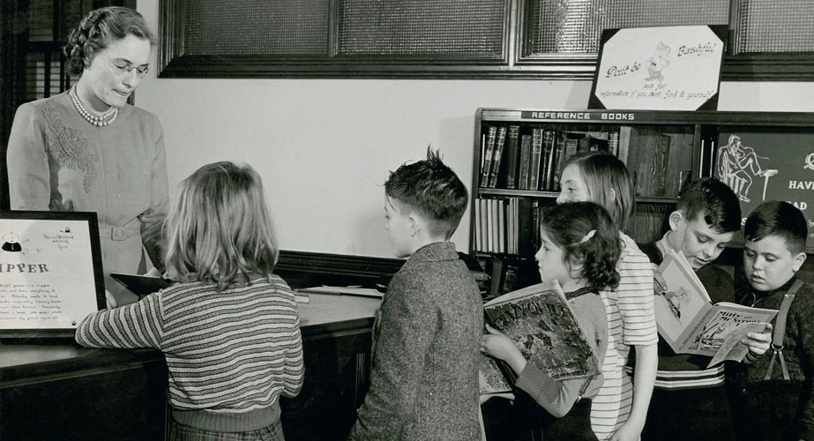
Social change

Slide 3

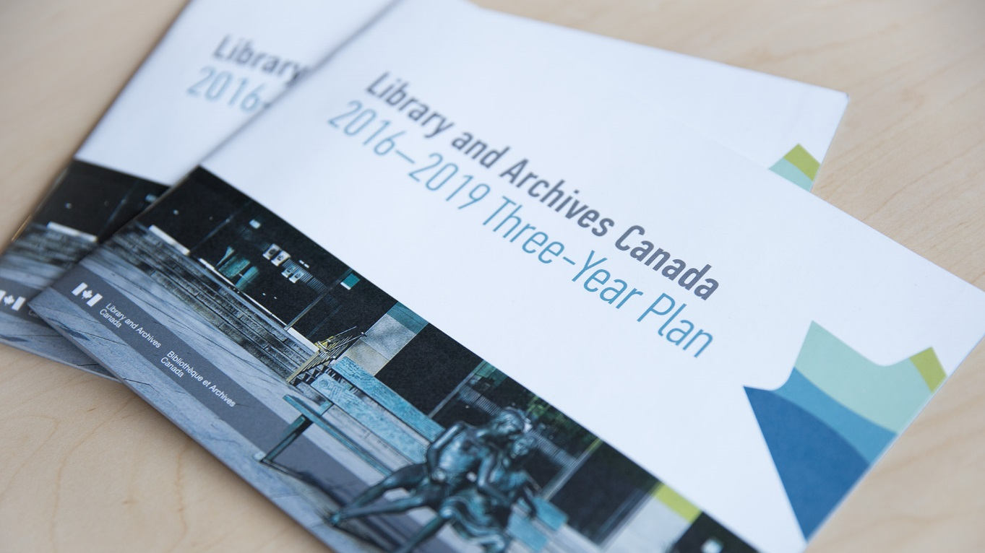
LAC’s Three Year Plan
2016 to 2019
Analysed twelve major trends
Seven related to digital
Including:
  Connectivity
  Mobile apps
  Long-term digital preservation

Slide 4
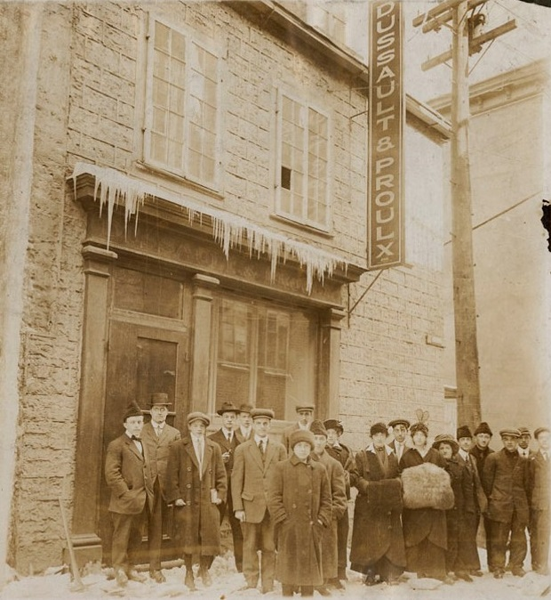
Digital publishing
E-books
Self-publishing
Digital libraries

Slide 5
Digital Public Library of America
Free online access
14 million items
Over 2,000 contributing institutions

Slide 6


Slide 7
Main branches
Public services
Preservation
Published heritage
Private archives
Government records

Slide 8
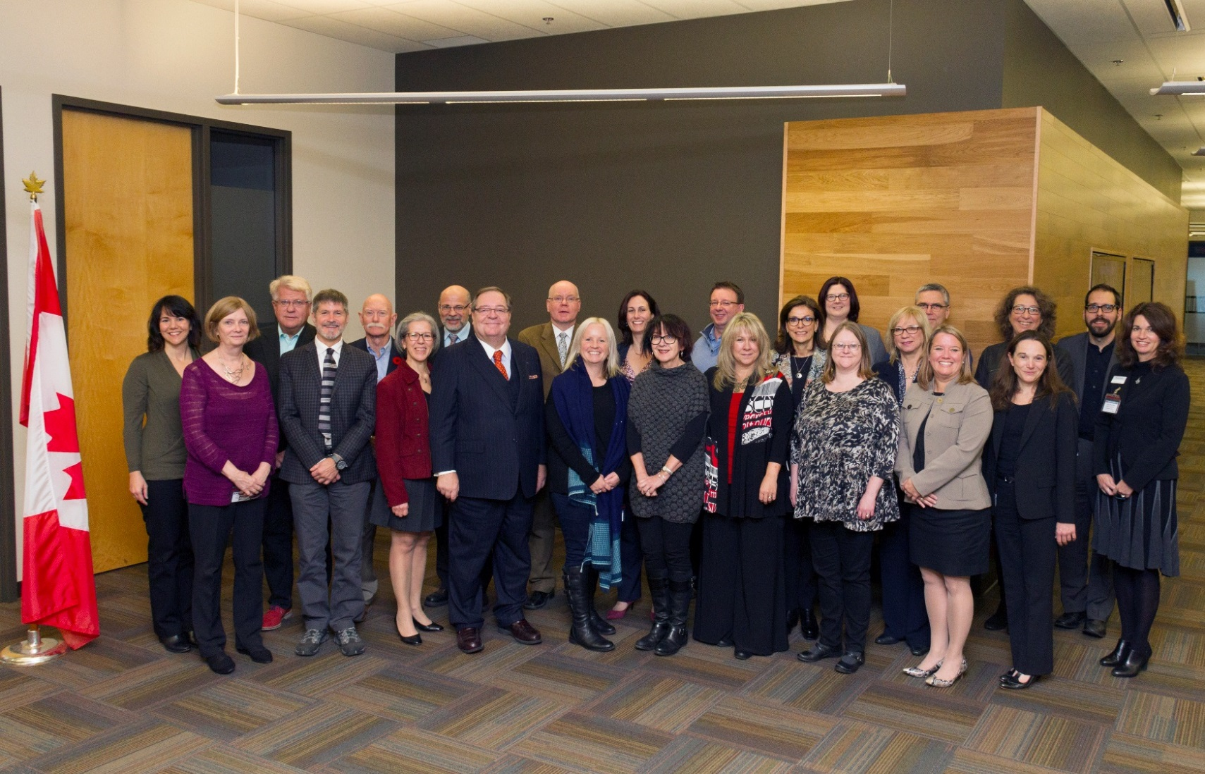
Stakeholders’ Forum

Slide 9
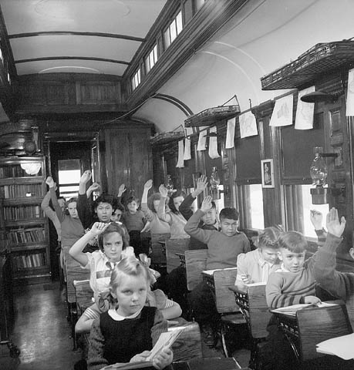
Professional competencies
Information resources
Information access
Technology
Management
Research

Slide 10
New competencies in the digital era
Adapting business models to a new environment
Specialized knowledge and “all-purpose” skills
Digital logic – leveraging technologies to enable networking and collaboration
Success will depend not only on adapting to technology…
But on vision, strategy, organizational culture, and redesigned processes

Slide 11

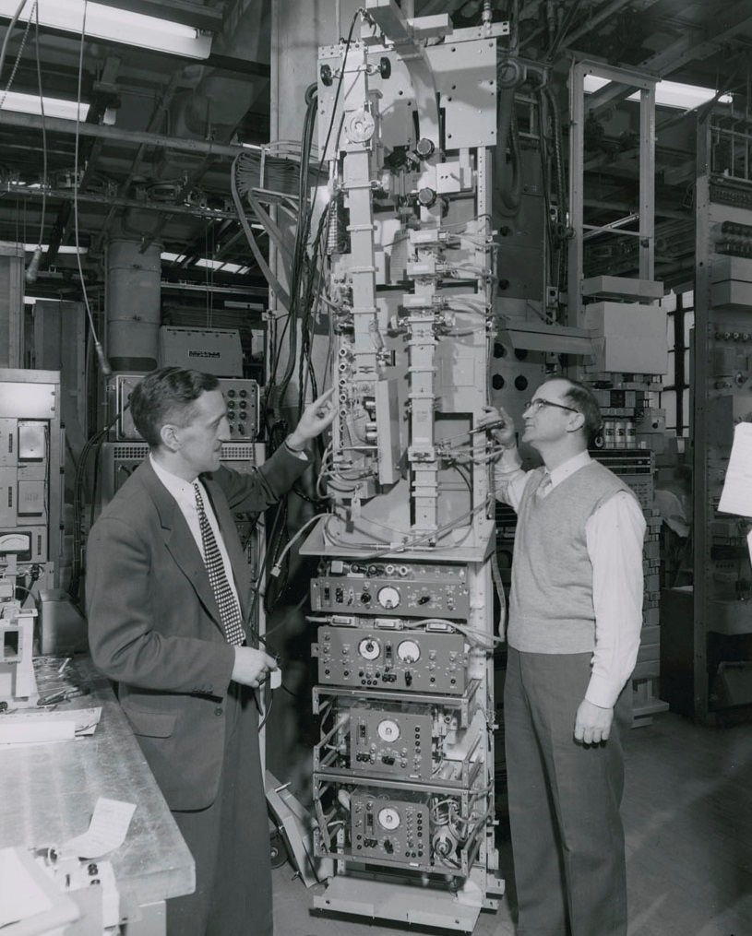
Framework for digital transformation 2.0
People
Collaboration
HR
Management

Slide 12
Build Our Future Through Our People
“We have an opportunity to become more – to find ways to be more supportive of our staff, better at our jobs, savvier in our decisions, and bolder in our commitment to leading the archival and information professions to ensure continued relevance and flourishing of archives in a digital society.”
                NARA Strategic Plan, 2014-2018

Slide 13
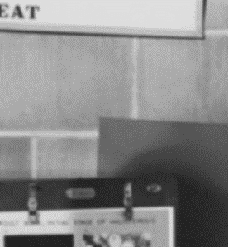
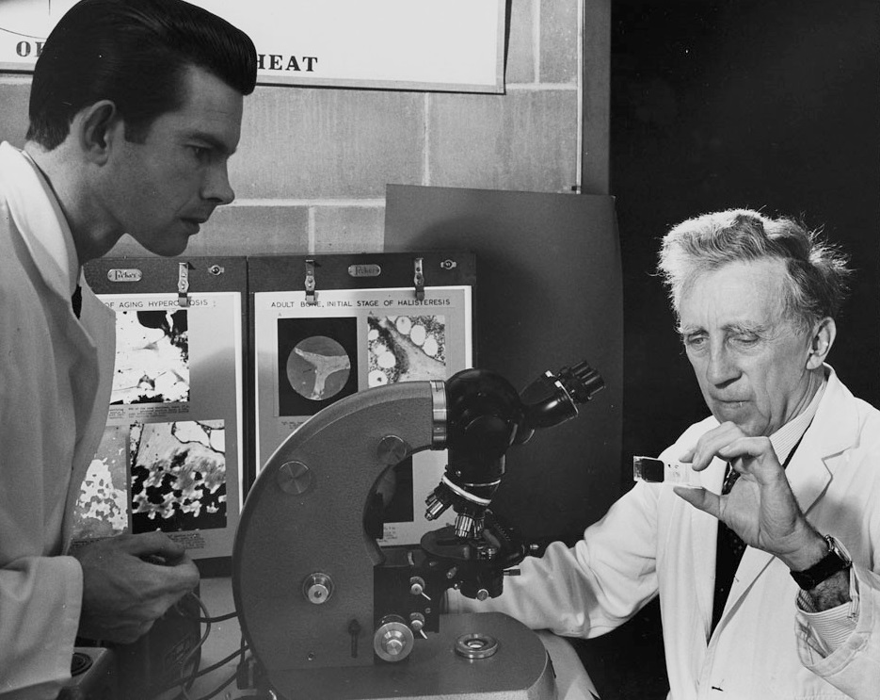
Sharing expertise, knowledge and technology
University of Ottawa
Dalhousie University

Slide 14

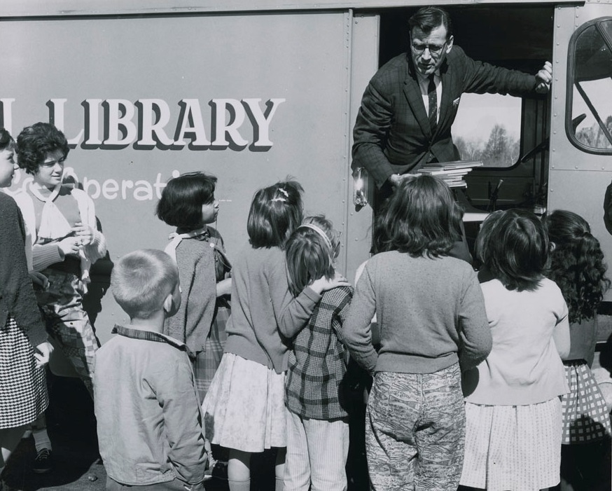
The field of knowledge…
common property

Slide 15
A new reality
Number of publications doubles every two years
New conversations on Twitter, Facebook etc
Many publications available in digital format only
Where does the information live?
    online journals,
    online research,
    big data,
    databases
    blogs
    podcasts etc.

Slide 16
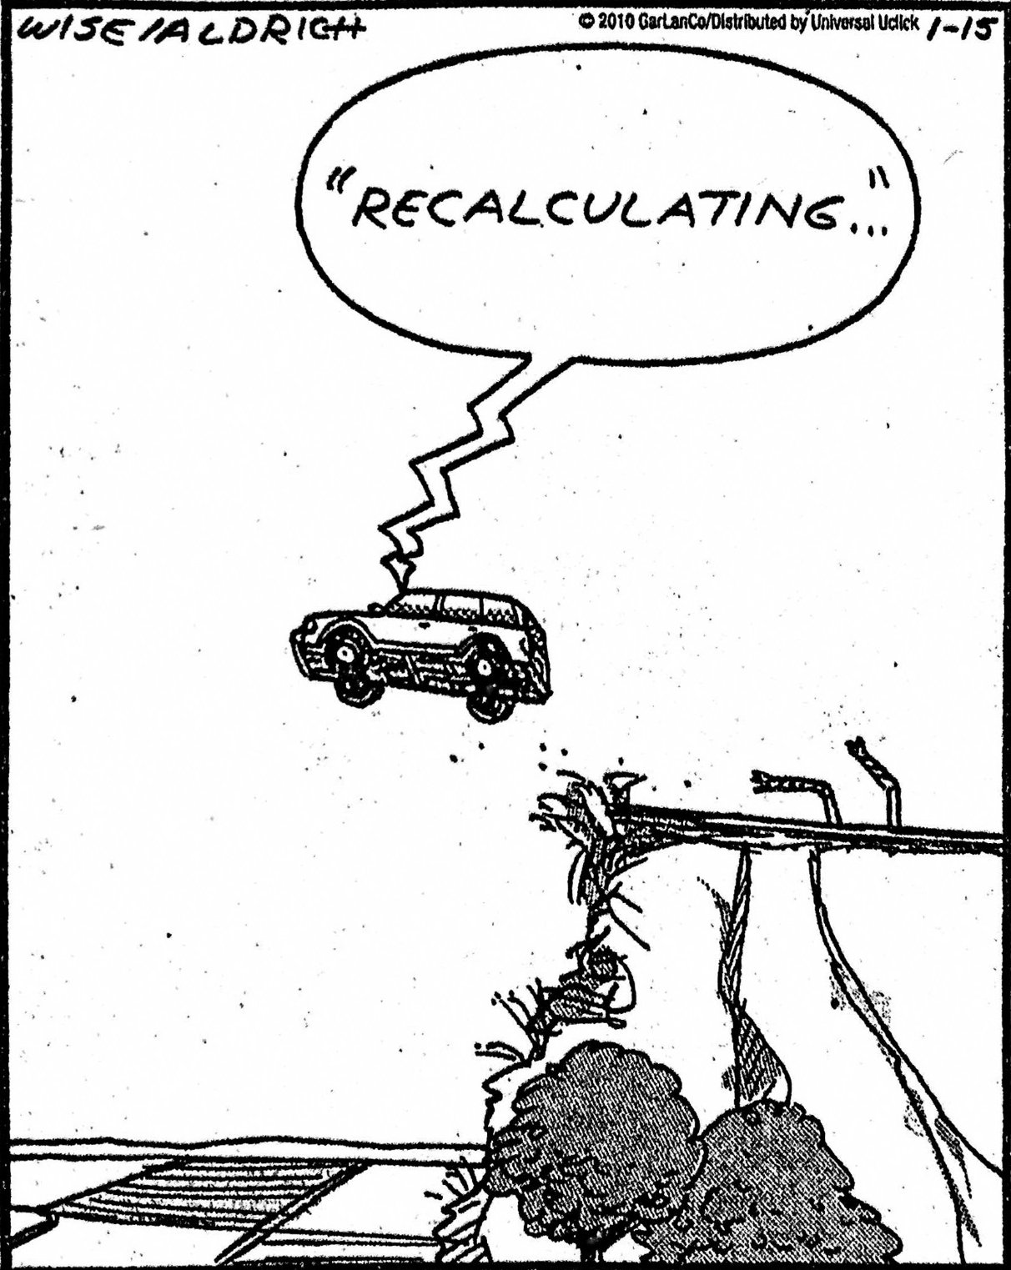
Is Google
Making Us Stupid?

Slide 17
Necessary skills
Seeing the big picture
Communicating
Working as a team
Thinking critically
Committed to life-long learning
Discipline- specific skills
The third element: information technology

Slide 18
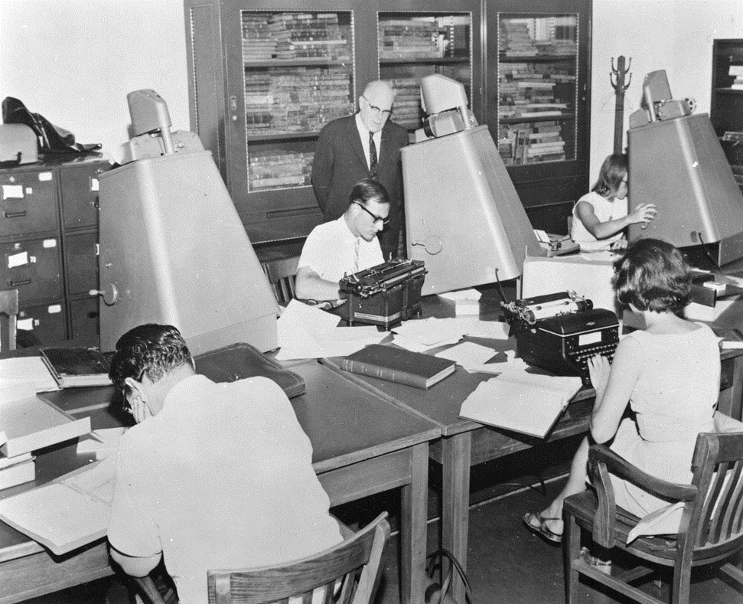
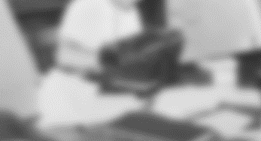
The information
commons: then

Slide 19
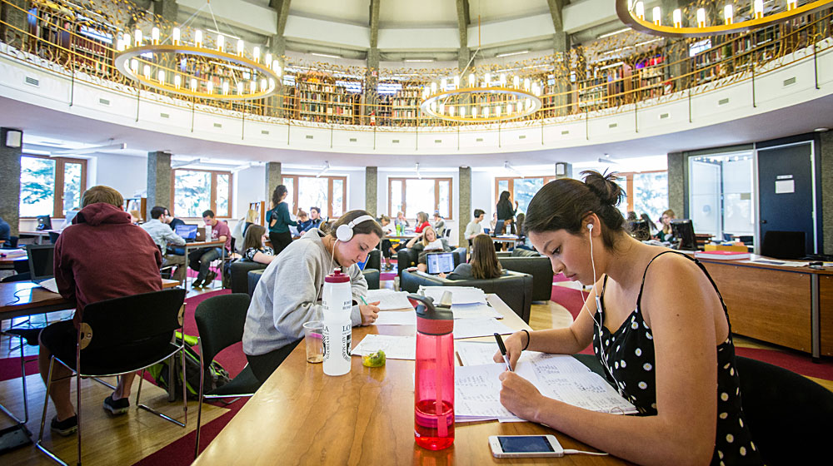
And now: Information Commons, Loyola University

Slide 20
Workforce development
Workshops
Practical training
Online courses
On the job experience
Pairing and job shadowing
Self study
Personal development

Slide 21
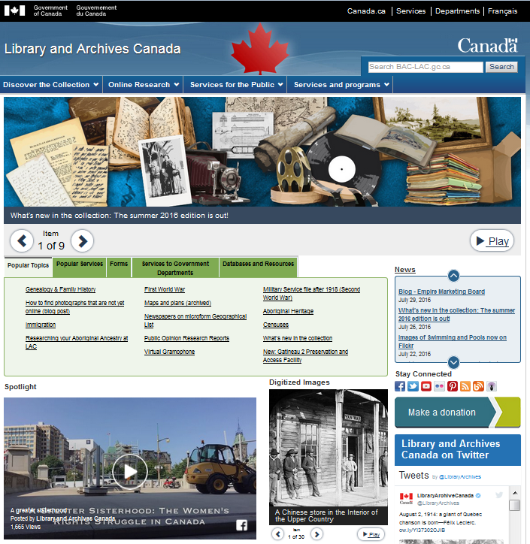
Accessing information at LAC
Website: 90M visits a month
25M digital images online
11,000 blog visits a month
Flickr: 225,000 views a month

Slide 22
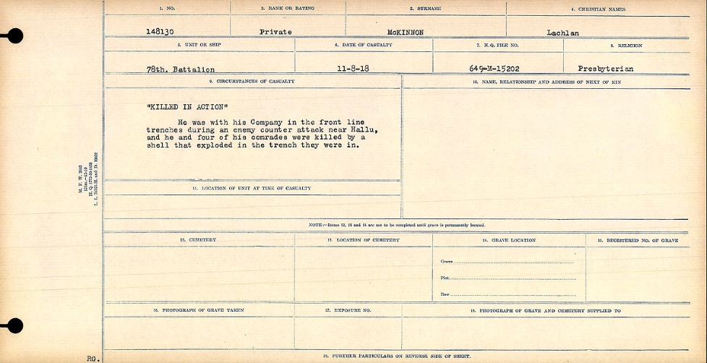
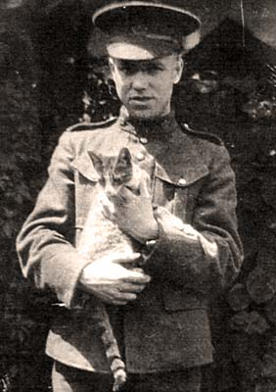
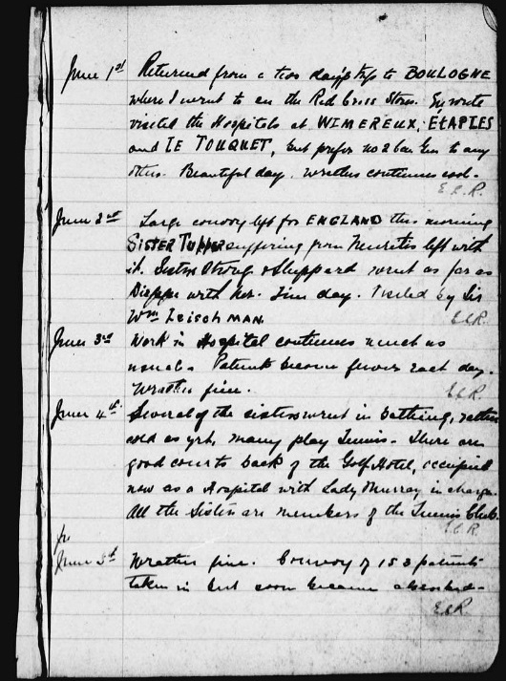
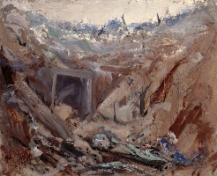
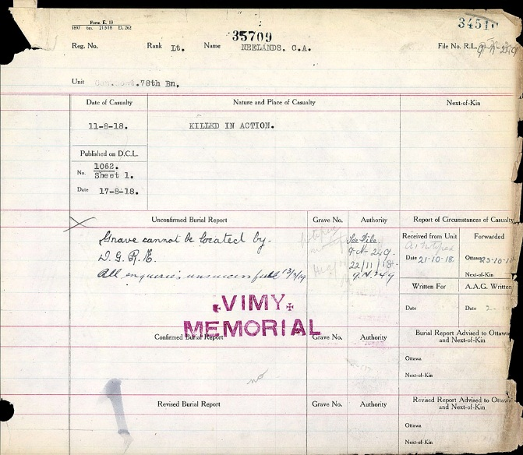
Digitizing 640,000 records of the Canadian Expeditionary Forces from WW1

Slide 23
